Slide 1



Section E-Group: 16
Predictive Analytics for
Loan Default Risk
A Comprehensive Data Study
Sector :Banking, Financial Services, and Insurance (BFSI)
By: Ananya soni | Param Khodiyar | Ansh Tomar | Himanshu | Kaavya Gala | Gauri mishra

Slide 2




Why it matters?: In the BFSI (Banking, Financial Services, and Insurance) sector, interest income is the primary revenue driver, but Loan Defaults are the primary threat to capital stability.
The Challenge: Aggressive lending grows the portfolio but increases the risk of Non-Performing Assets (NPAs). Conversely, overly cautious lending leads to missed market opportunities.
Decision-Maker: Chief Risk Officer (CRO), Credit Underwriting Managers, and Financial Analysts.
Sector Context:
The High Stakes of Lending

Slide 3

Objective:
Problem Statement:
The primary objective of this project is to analyze historical loan data to:
Identify Key Risk Drivers: Determine which factors (e.g., Credit Score, LTV, or Loan Purpose) most accurately predict a default.
Optimize Underwriting: Support the decision of whether to approve, reject, or adjust interest rates based on a borrower's specific risk profile.
Visual Storytelling: Create a dashboard that allows stakeholders to monitor portfolio health across different regions and demographics.
Financial institutions face significant losses due to borrower defaults, often driven by complex interactions between debt-to-income ratios , property valuations, and borrower credit history.
How can we identify high-risk applicants early in the application process to minimize credit loss without turning away creditworthy customers?

Slide 4



Data Engineering (Source to Sink)
Data Source & Profile
Data Cleaning & Preprocessing
Data Dictionary
Dataset Name: Loan Default Dataset (Multi-variable Financial Records).
Dimensions:
Rows: 10,000
Columns: 35
Time Period: 2019
Format: Structured CSV ready format.
We replaced technical codes with full names.
Missing interest rates and Income used the median value.
Removed extra spaces from text cells.
Target Variable – Status
Loan Details – Loan Amount, Rate of Interest
Demographics – Age, Region, Income

Slide 5
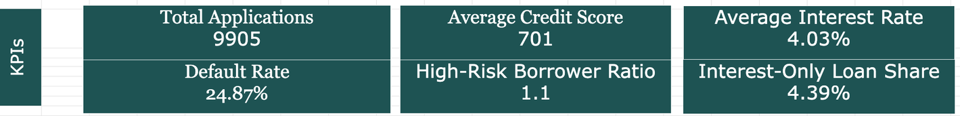

KPI & Metrics Framework
Average Rate of Interest: 4.03%
Default Rate & Credit Score: These are our "Early Warning" signals. A 24.87% default rate is high; we monitor these to identify if we are lending to the wrong risk profiles.
Total Loan Amount & Applications: These measure our market reach and scale. They show if the business is expanding or shrinking.
Rate of Interest: This is our primary revenue driver. We analyze this against the Default Rate to see if higher interest rates are leading to more defaults.
Total Applications: 9,767
Total Loan Amount: $333.9 Million
Default Rate: 24.87%
Average Credit Score: 701

Slide 6



EDA
Regional Risk Concentration: The North-East region shows a staggering 40% default rate for low-score borrowers. This geographical hotspot requires immediate credit policy review.
The Prime Borrower Trap: High credit score borrowers (750+) accounts for 928 total defaults. High scores alone are not preventing significant losses.
Collateral Risk Extremes: Loans with LTV ratios over 100 have a 71% default rate. Lending more than the property's value is extremely risky.
Loan Type Performance: "Type 2" loans show the highest default rate at 33%. This specific loan structure is underperforming compared to others.
Income Stability Observation: Average income remains flat across all credit bands. Borrower earnings are not increasing alongside their credit scores.
Co-applicant Lending Power: "EXP" co-applicants secure much higher average loan amounts. Joint applications are driving the largest capital deployments.

Slide 7

Advanced Analysis
Risk Segmentation & Root Cause Analysis
We performed a deep-dive segmentation to find the "Danger Zones" within our data:
Defaults spike sharply when LTV exceeds 100%.
North-East region shows elevated default risk.
Type 2 loans exhibit the highest failure rate.
What New Understanding Did This Provide?
Credit Scores are Not Enough: High scores (750+) do not protect us if the LTV ratio is too high.
Geography Matters: Repayment behavior is heavily influenced by the borrower's Region, not just their personal finances.
Structural Risk: Our current "Type 2" loan structure is fundamentally riskier than other products we offer.

Slide 8
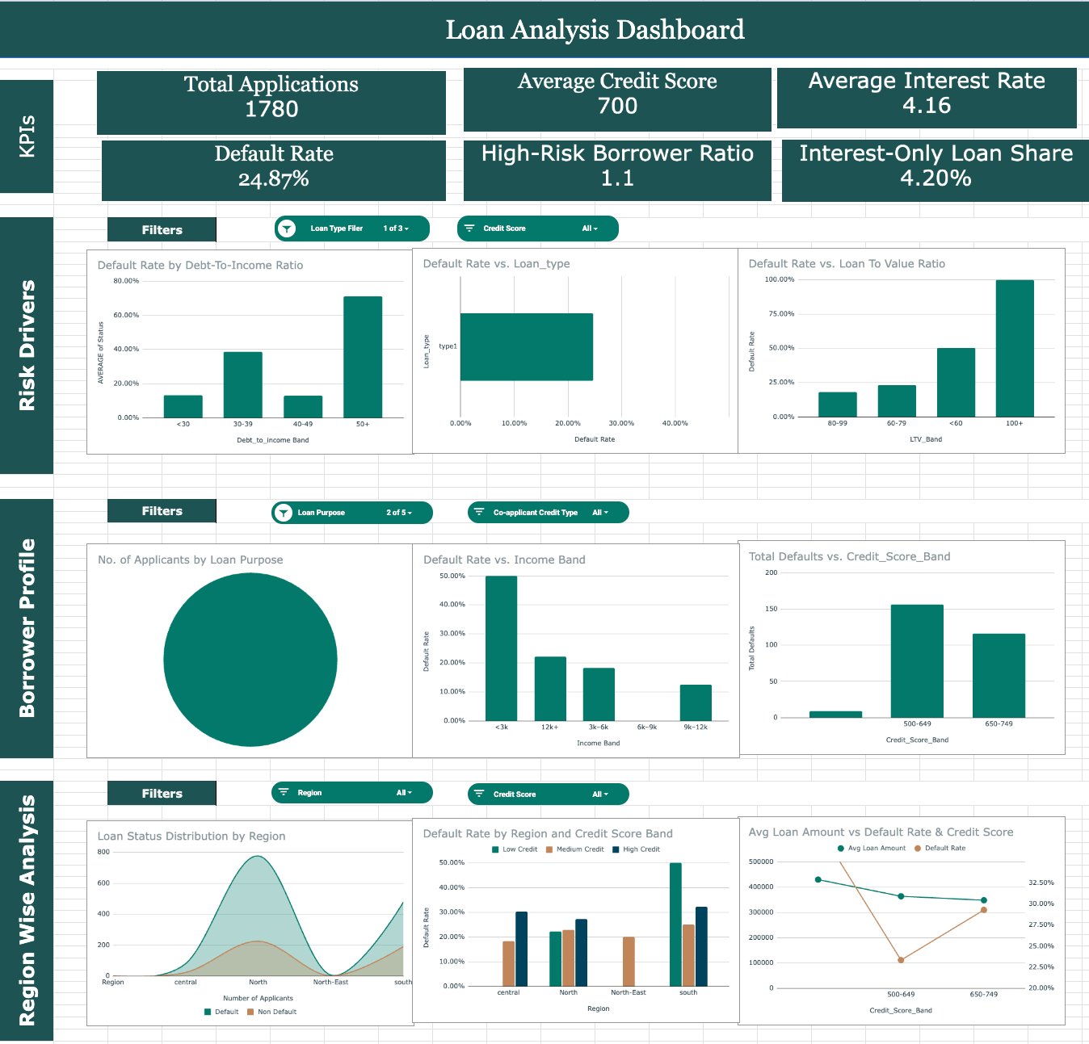
• Shows key KPIs including Default Rate, Credit Score, Interest Rate, and Risk Ratios.
• Visualizes defaults across LTV, DTI, Loan Type, and Region.
• Interactive filters enable dynamic portfolio analysis.
• Highlights risk patterns and borrower segmentation.

Slide 9

Recommendations
Tighten LTV Thresholds: Stop approving loans with an LTV over 100%, as these currently result in a 71% default rate.
Regional Risk Mitigation: Implement stricter credit requirements for the North-East region, where low-score defaults hit 40%.
Re-evaluate "Type 2" Products: Audit the Type 2 loan structure to identify why its 33% default rate is significantly higher than other types.
Enhanced DTI Checks: For high credit score borrowers (750+), prioritize Debt-to-Income (dtir1) analysis over scores to prevent "Prime" defaults.
Co-applicant Limits: Place a cap on total loan amounts for EXP co-applicant types to reduce high-capital exposure in risky segments.

Slide 10
Impact & Value
Why should the stakeholder approve this?
"So What?"
IMPACT
VALUE
Reduced Credit Loss: By eliminating loans with LTV>100, we can potentially prevent a significant portion of our 24.87% default rate.
Capital Efficiency: Redirecting funds from high-risk Type 2 loans to safer products ensures better returns on our $333.9M portfolio.
Targeted Risk Management: Focusing on the North-East region reduces operational costs by identifying high-risk areas before defaults occur.
Protect Assets: Implementing these changes protects the principal amount of future loans from "high-score" defaults.
Data-Driven Growth: Moves the bank from "guessing" to using Pivot Table insights for more accurate lending decisions.
Profitability: Lowering the default rate directly increases the net profit margin from the 4.03% average interest rate.

Slide 11
Limitations
Time-Specific Insights: The analysis reflects the 2019 economic climate; future iterations could incorporate post-pandemic shifts to test model resilience.
Scope of Variables: While our financial metrics are robust, adding "Employment Tenure" would further sharpen the prediction of borrower stability beyond debt ratios like dtir1.
Methodological Precision: We utilized Median Imputation for rate_of_interest to maintain statistical integrity; future work could use advanced regression to predict these missing values even more accurately.

Slide 12


Next Steps
Predictive Modeling: Moving from spreadsheet analysis to Machine Learning (like Logistic Regression) to automate default probability scores.
Dynamic Dashboards: Integrating live data feeds to track how the Default Rate fluctuates in real-time as market interest rates change.
Granular Segmentation: Collecting more data on Property Location to understand why the North-East region is such a high-risk outlier.

